Slide 1

Activity Recognition
Done by: Ahmad Abdel-Qader

Slide 2
First Training
Dataset: Serhat collected data + Kaggle data
Total number of features = 12.
Features: acceleration X, acceleration Y, acceleration Z, gyroscope X, gyroscope Y, gyroscope Z, body acceleration X, body acceleration Y, body acceleration Z, RMS acceleration, RMS gyroscope, RMS body acceleration.
Total number of labels = 8.
Labels (output): walking, going upstairs, going downstairs, standing, running, elevator, falling, car in or out.

Slide 3
Results:
Training accuracy: 97.57%
Validation accuracy: 96.59%
Test accuracy: 96.81%

Slide 4
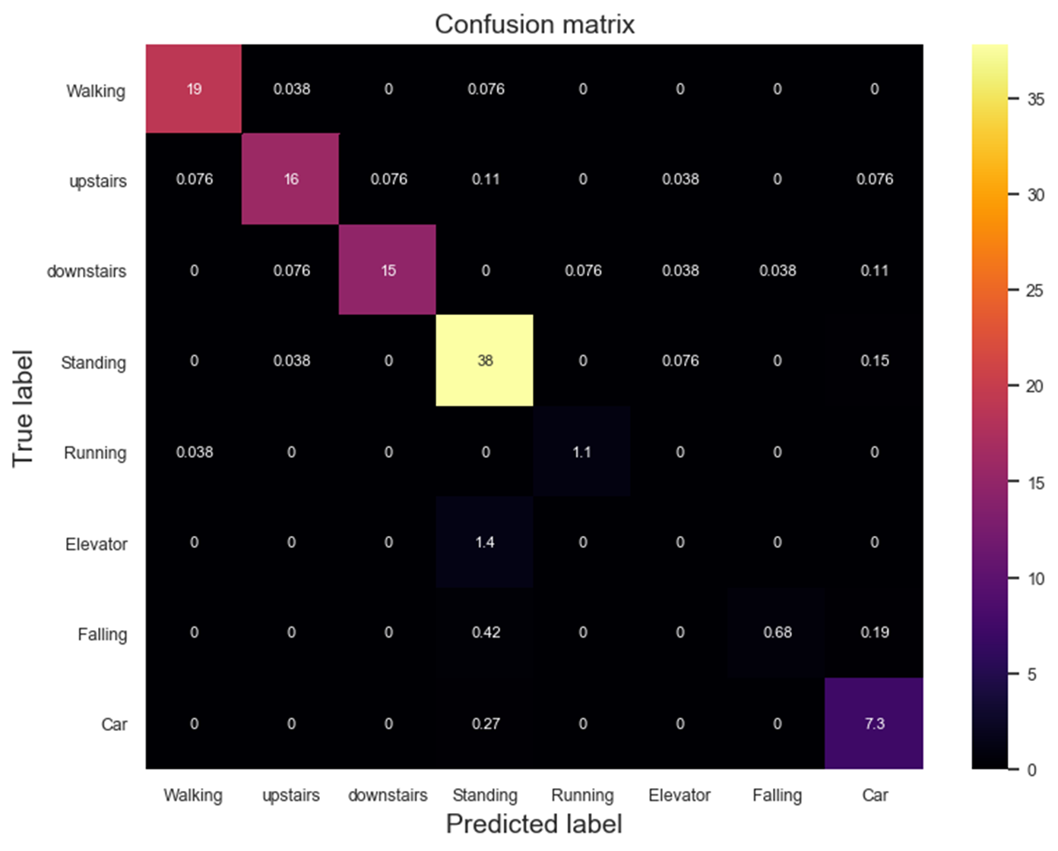

Slide 5
Second Training:
Dataset: only data collected by Serhat.
Total number of features = 12.
Features: acceleration X, acceleration Y, acceleration Z, gyroscope X, gyroscope Y, gyroscope Z, body acceleration X, body acceleration Y, body acceleration Z, RMS acceleration, RMS gyroscope, RMS body acceleration.
Total number of labels = 8.
Labels (output): walking, going upstairs, going downstairs, standing, running, elevator, falling, car in or out.

Slide 6
Results:
Training accuracy: 88.52%
Validation accuracy: 86.89%
Test accuracy: 87.42%

Slide 7
Third Training:
Dataset: only data collected by Serhat.
Total number of features = 15.
Features: acceleration X, acceleration Y, acceleration Z, gyroscope X, gyroscope Y, gyroscope Z, body acceleration X, body acceleration Y, body acceleration Z, RMS acceleration, RMS gyroscope, RMS body acceleration, magnetometer X, magnetometer Y, magnetometer Z.
Total number of labels = 8.
Labels (output): walking, going upstairs, going downstairs, standing, running, elevator, falling, car in or out.

Slide 8
Results:
Training accuracy: 96.02%
Validation accuracy: 95.97%
Test accuracy: 98.11%

Slide 9
